Slide 1
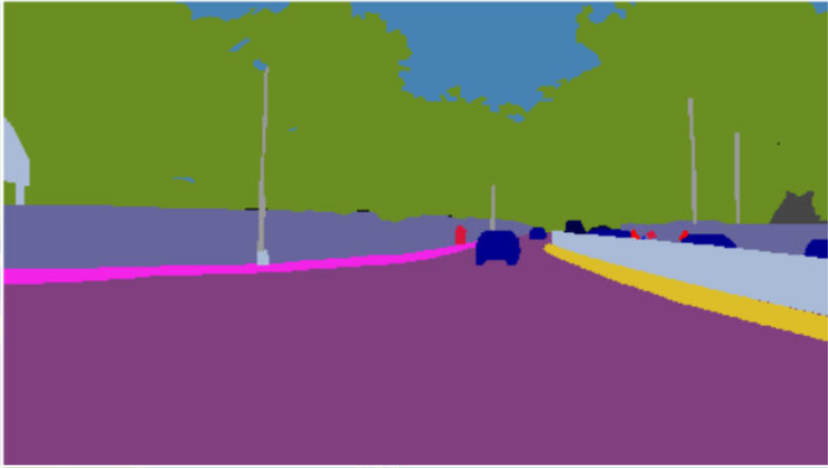
Domain Adaptation for Urban Scene Understanding
Tarun Kalluri
Advisor: Manmohan Chandraker
Centre for Visual Computing, UCSD
Notes:
Hi everyone, I am Tarun, a first year PhD student.

Slide 2
Today’s talk
1. Domain Adaptation for Driving Scenes
2. Universal Semantic Segmentation
Notes:
Today, my talk will basically cover 1) 2)
3) and new research directions in the challenging task of cross task adaptation.

Slide 3
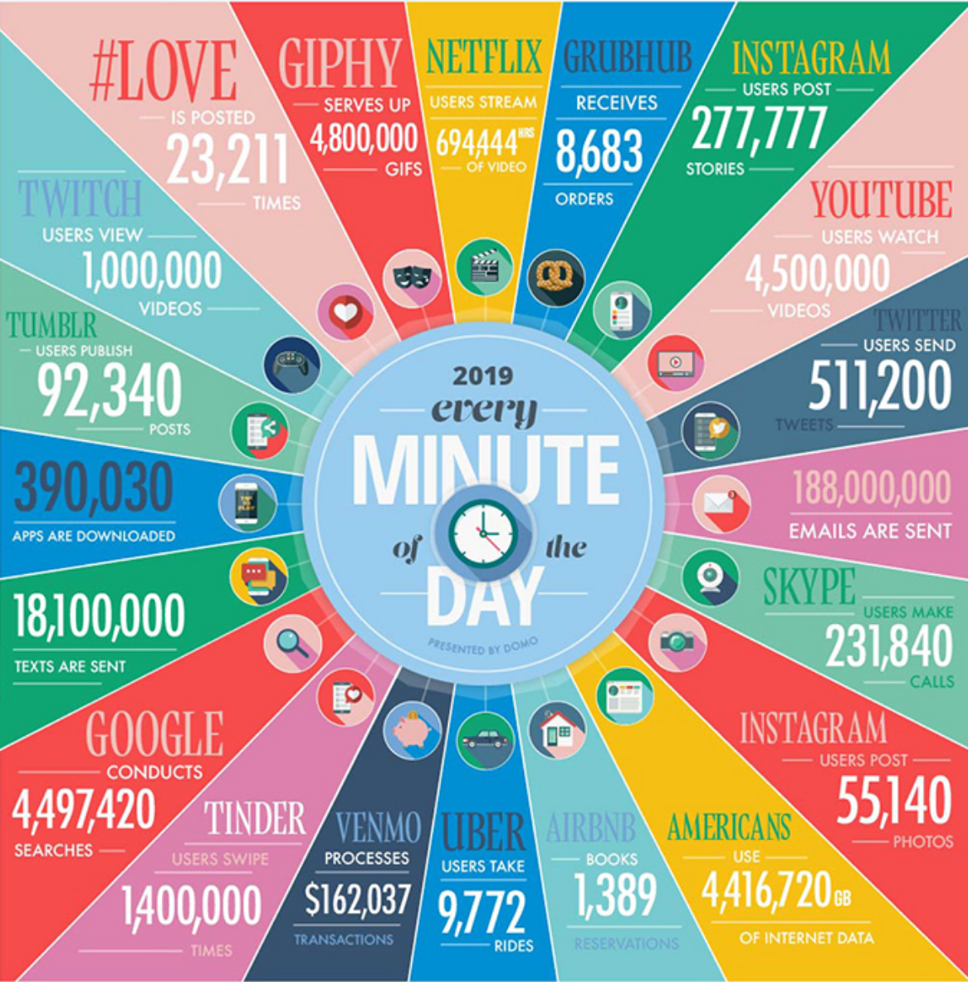
2020: Data is driving research
https://www.domo.com/blog/data-never-sleeps-4-0/
Notes:
Over the last few years, there has been humongous increase in the amounts of different kinds of data generated. This infograph tells us that per minute, there is around 4PB of data generated from internet in the form of images, videos, speeches etc. This data has invariably catalyzed research progress in data driven applications.

Slide 4
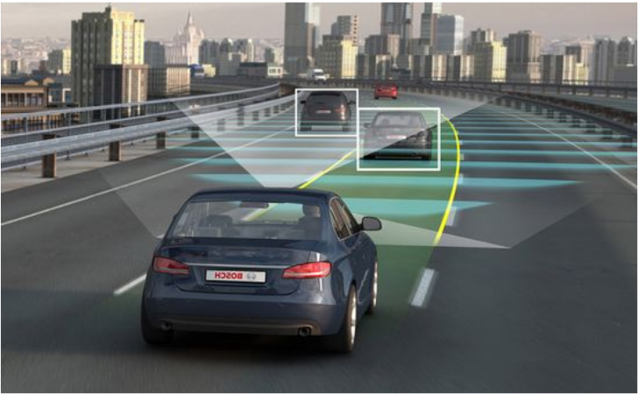
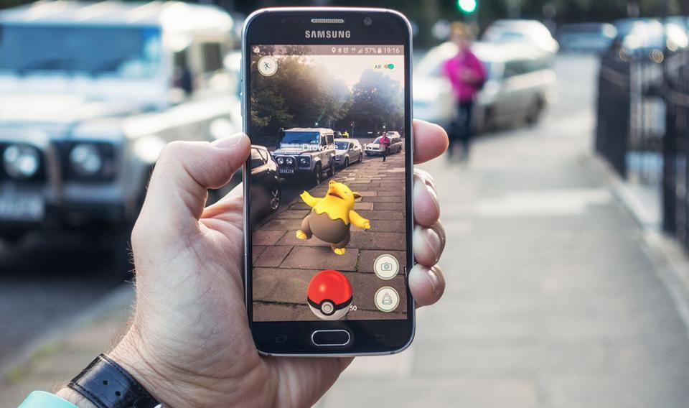
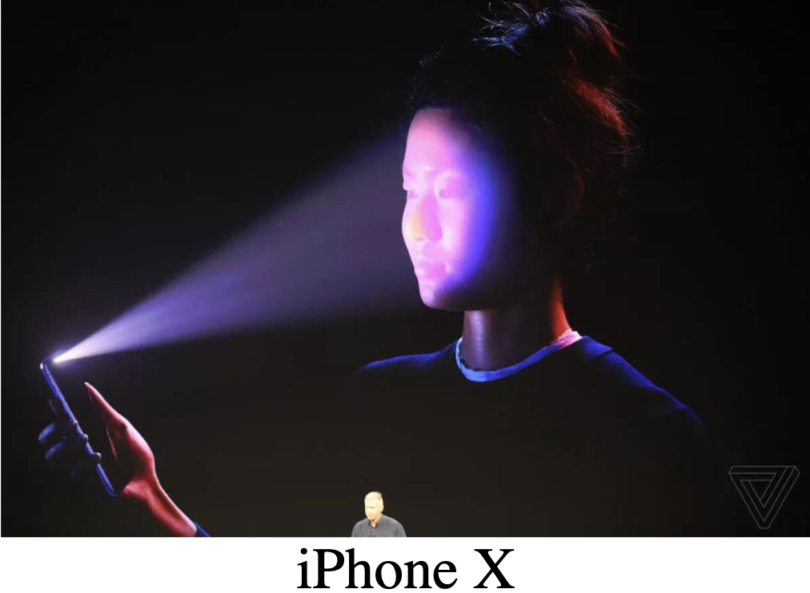
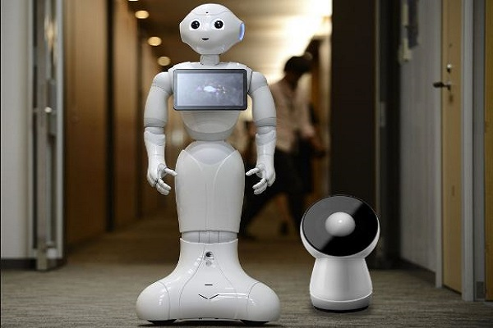
Computer vision
Autonomous Driving
Mobile AR / VR
Computer
Vision
Human Assisting Robots
Security / Surveillance
Notes:
One field which has seen great progress in research and ever growing interest over past few years is computer vision. This is especially attractive because of the variety of applications – ranging from autonomous driving where we need to deploy cars which reason about traffic and humans, security applications,

Slide 5
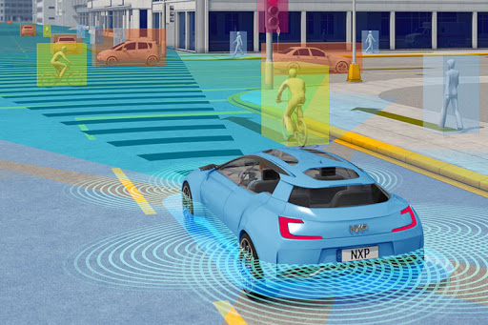
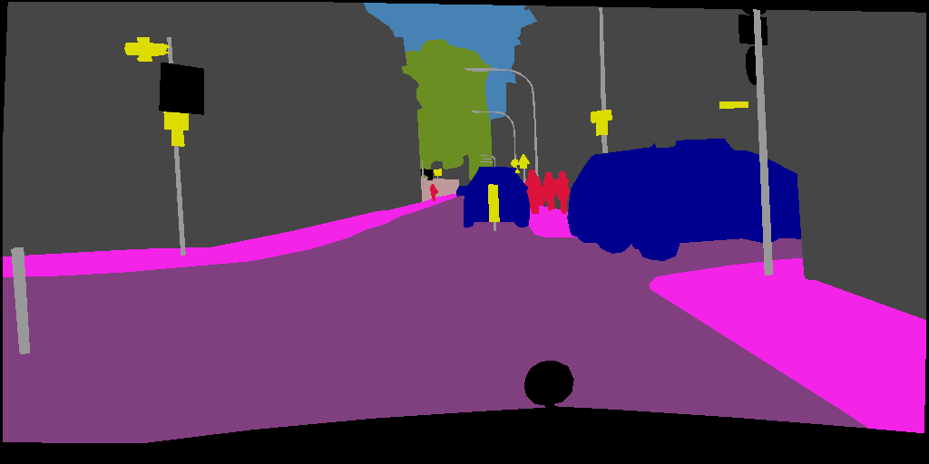
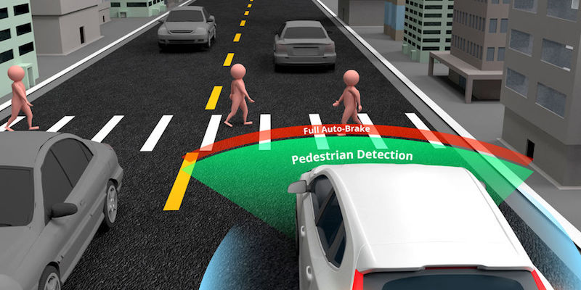
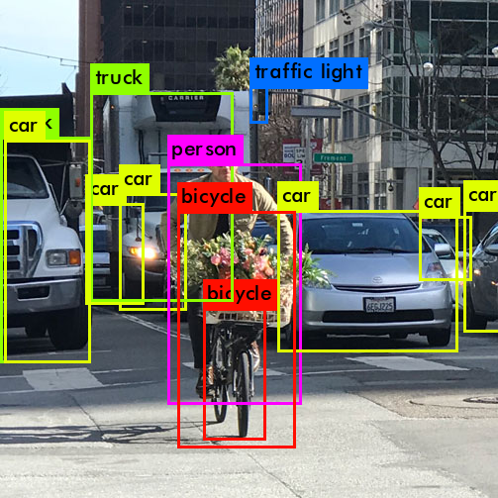
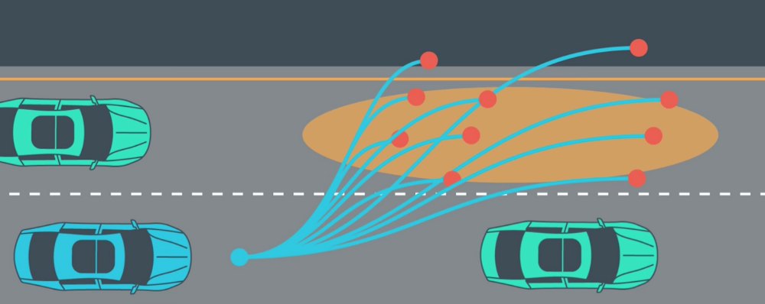
Holistic urban scene understanding
Sensing and perception
Semantic Segmentation
Pedestrian detection
Scene
Understanding
Object Detection
Path Planning
Notes:
One interesting and important problem in vision which I am going to focus on in my talk today is holistic scene understanding – where the goal is to make machines understand the contents of the scene as well as humans do.
In real world deployment, outdoor scenes change every moment, so machines need to do this kind of reasoning at regular intervals with low latency.

Slide 6
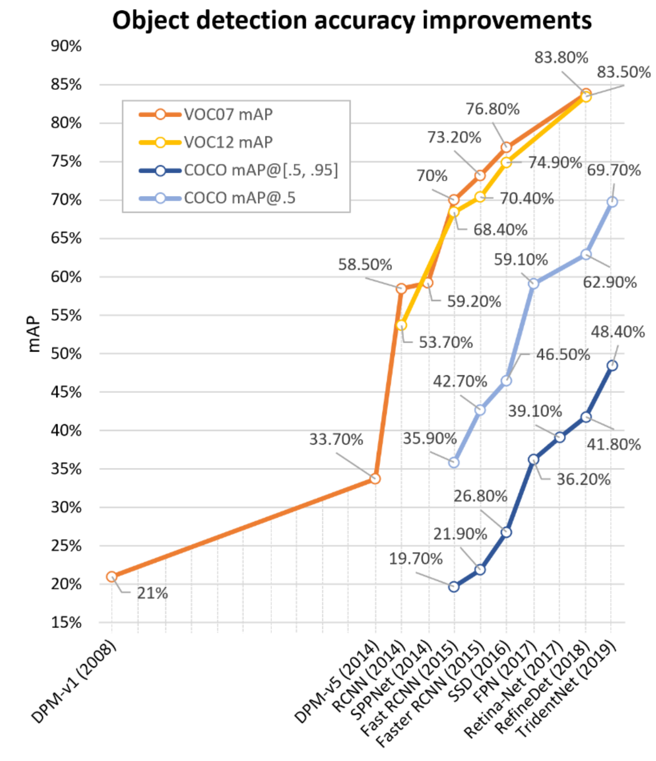
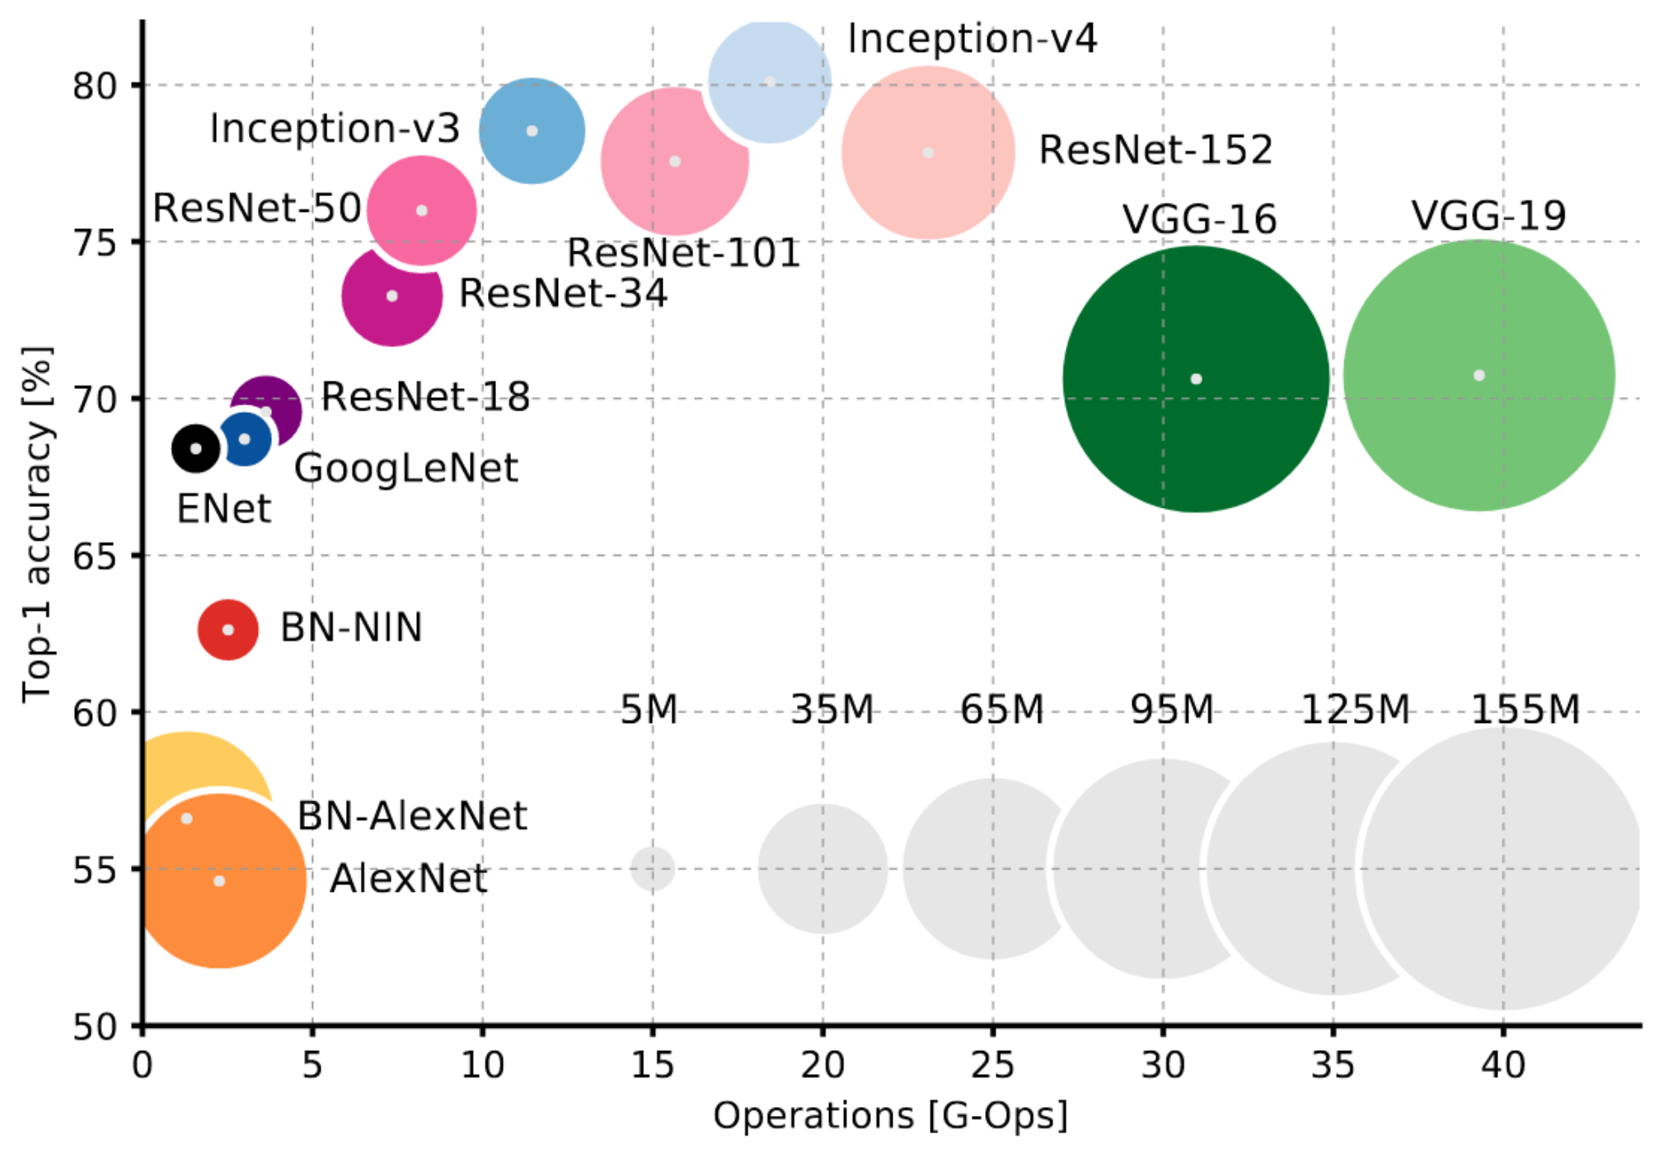
Transformation due to deep learning
Image Classification on ImageNet
Object Detection
Object Detection in 20 Years: A Survey[2019]
Notes:
In the past 6-7 years or so, the performance of most of these tasks have improved by several folds, thanks to recent innovations in deep learning. steepest improvements in most of these tasks have been obtained by using deep learning models. Example PASCAL-VOC12 SOTA around 80% - too good! So, there have indeed been some tangible benefits using techniques from deep learning.

Slide 7
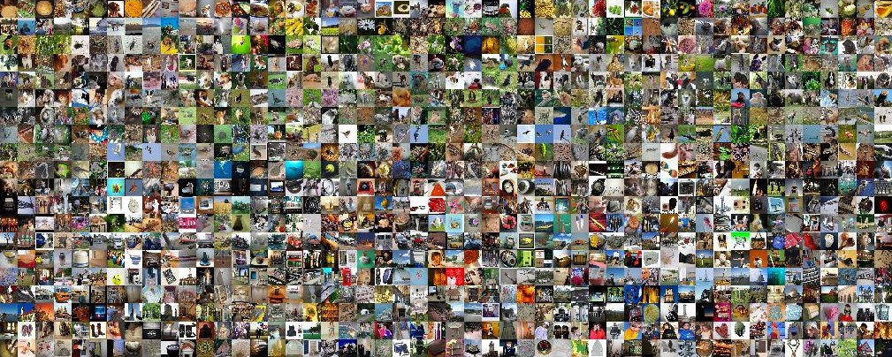
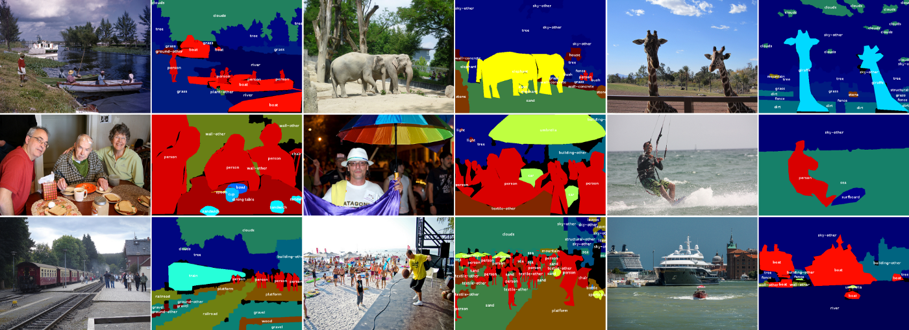
Crucial factor: Large labeled data
Places: A 10 million Image Database for Scene Recognition [2017]
Notes:
True for some tasks and some applications – Image Classification; ImageNet 1M images, Detection COCO 100k Images.

Slide 8
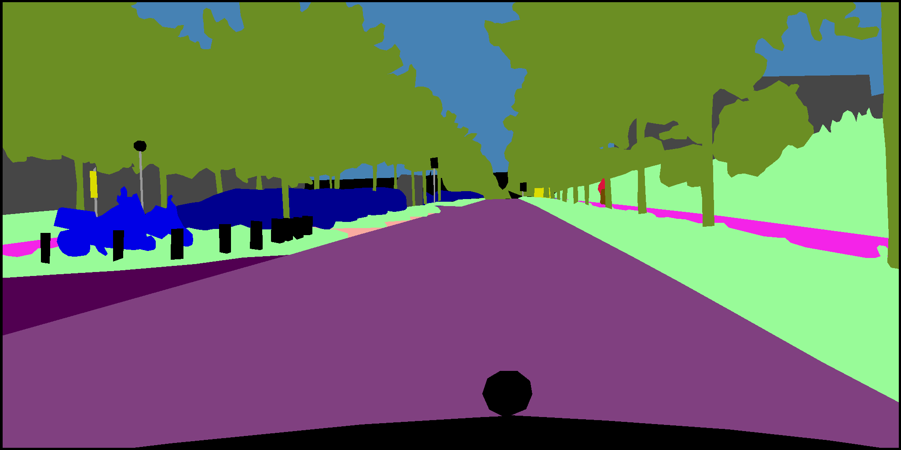
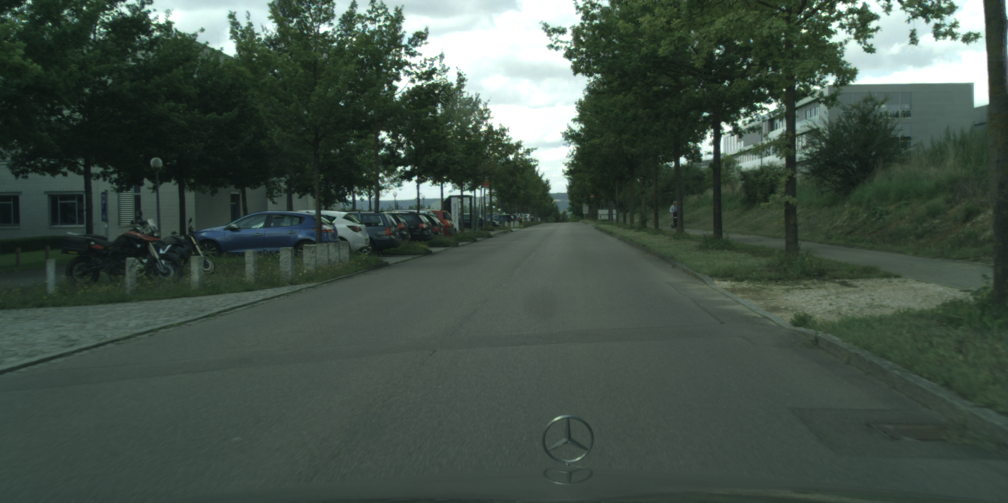
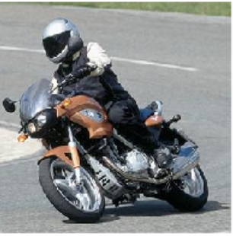
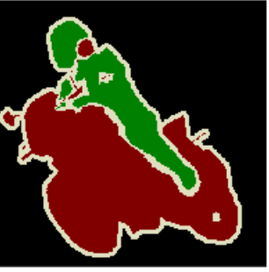
Semantic Segmentation

Slide 9
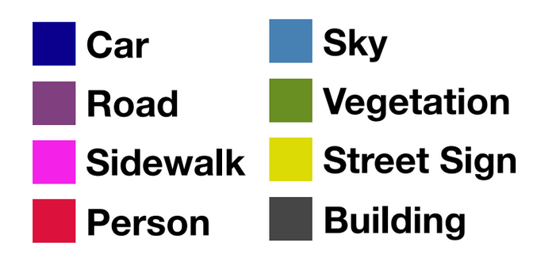
Data annotation: A serious challenge
TIME CONSUMING
90-96 min/Img
NOISE
Inter
annotator agreement
EXPENSIVE
10-12$ per image
Notes:
For practical real world applications, annotating data in large scale is infeasible.
Proprietary, Private, Identity theft
all of which make obtaining labeled data really challenging for even moderately hard problems.

Slide 10
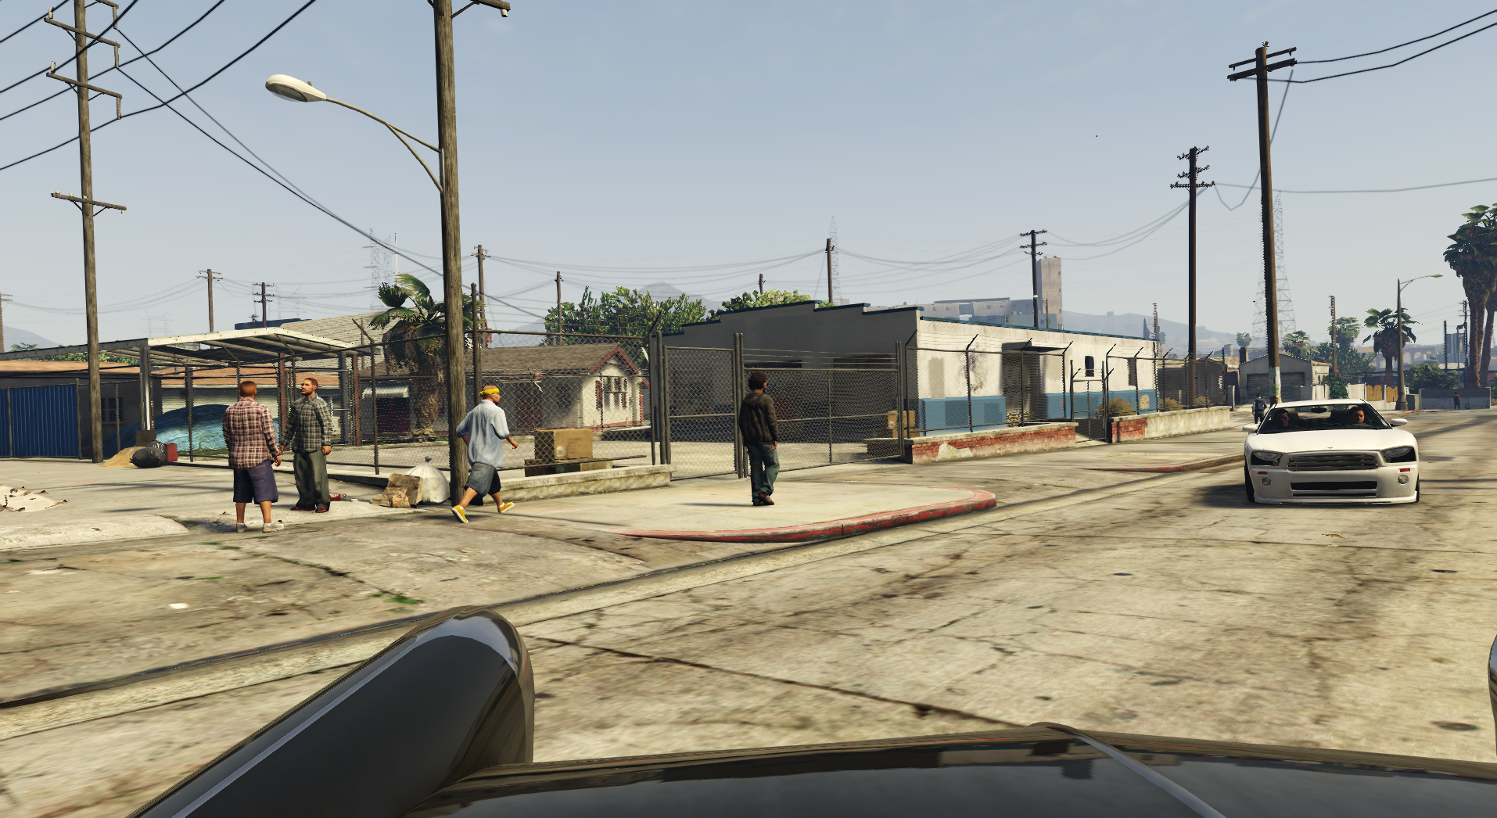
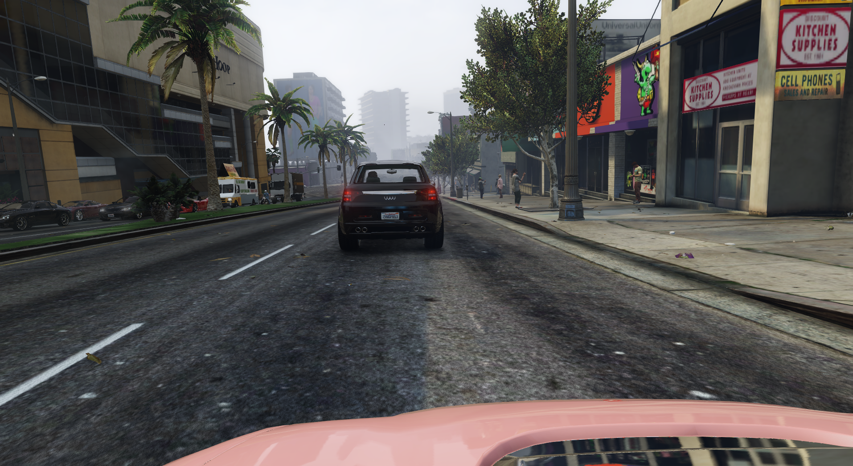
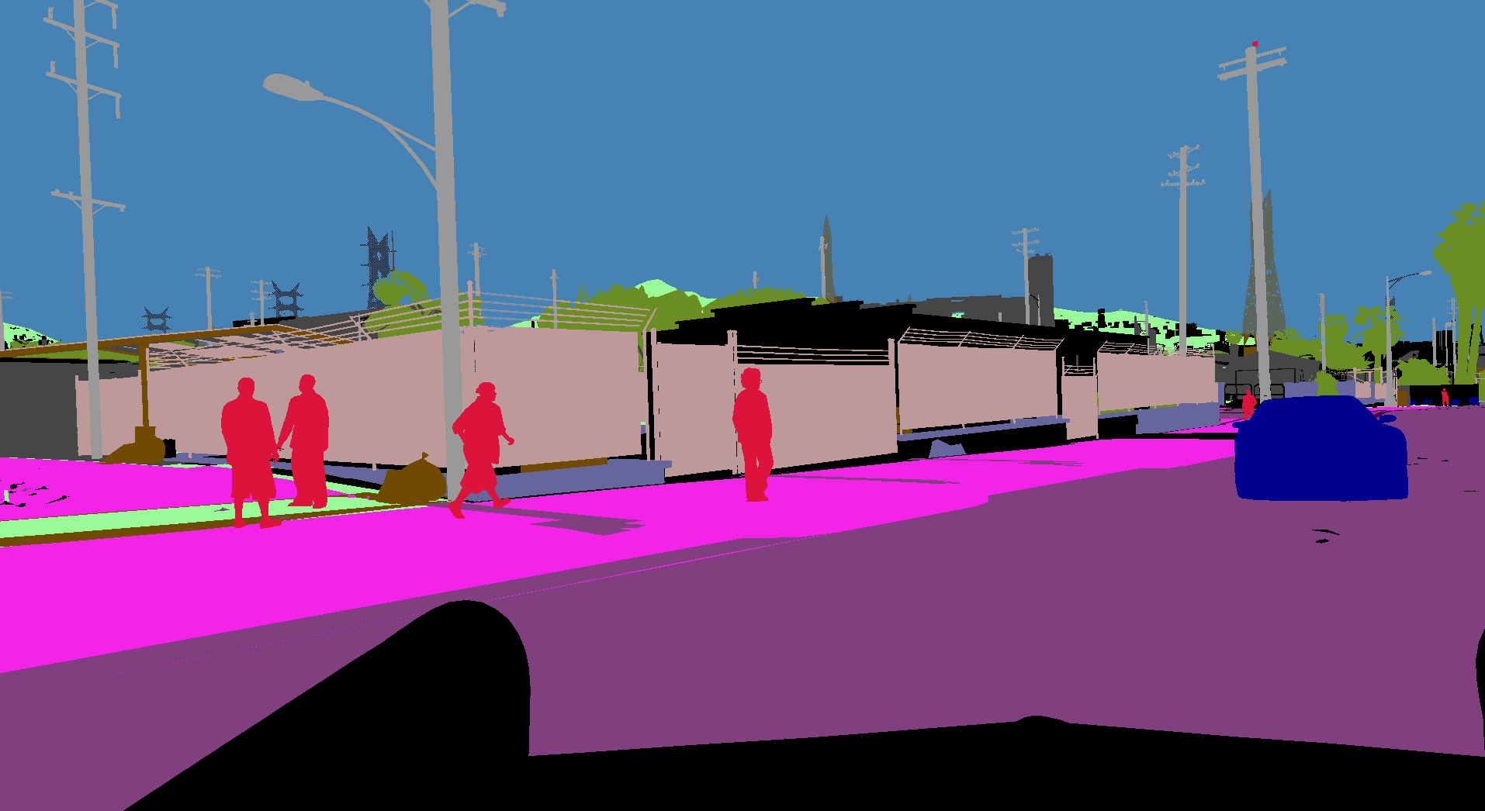
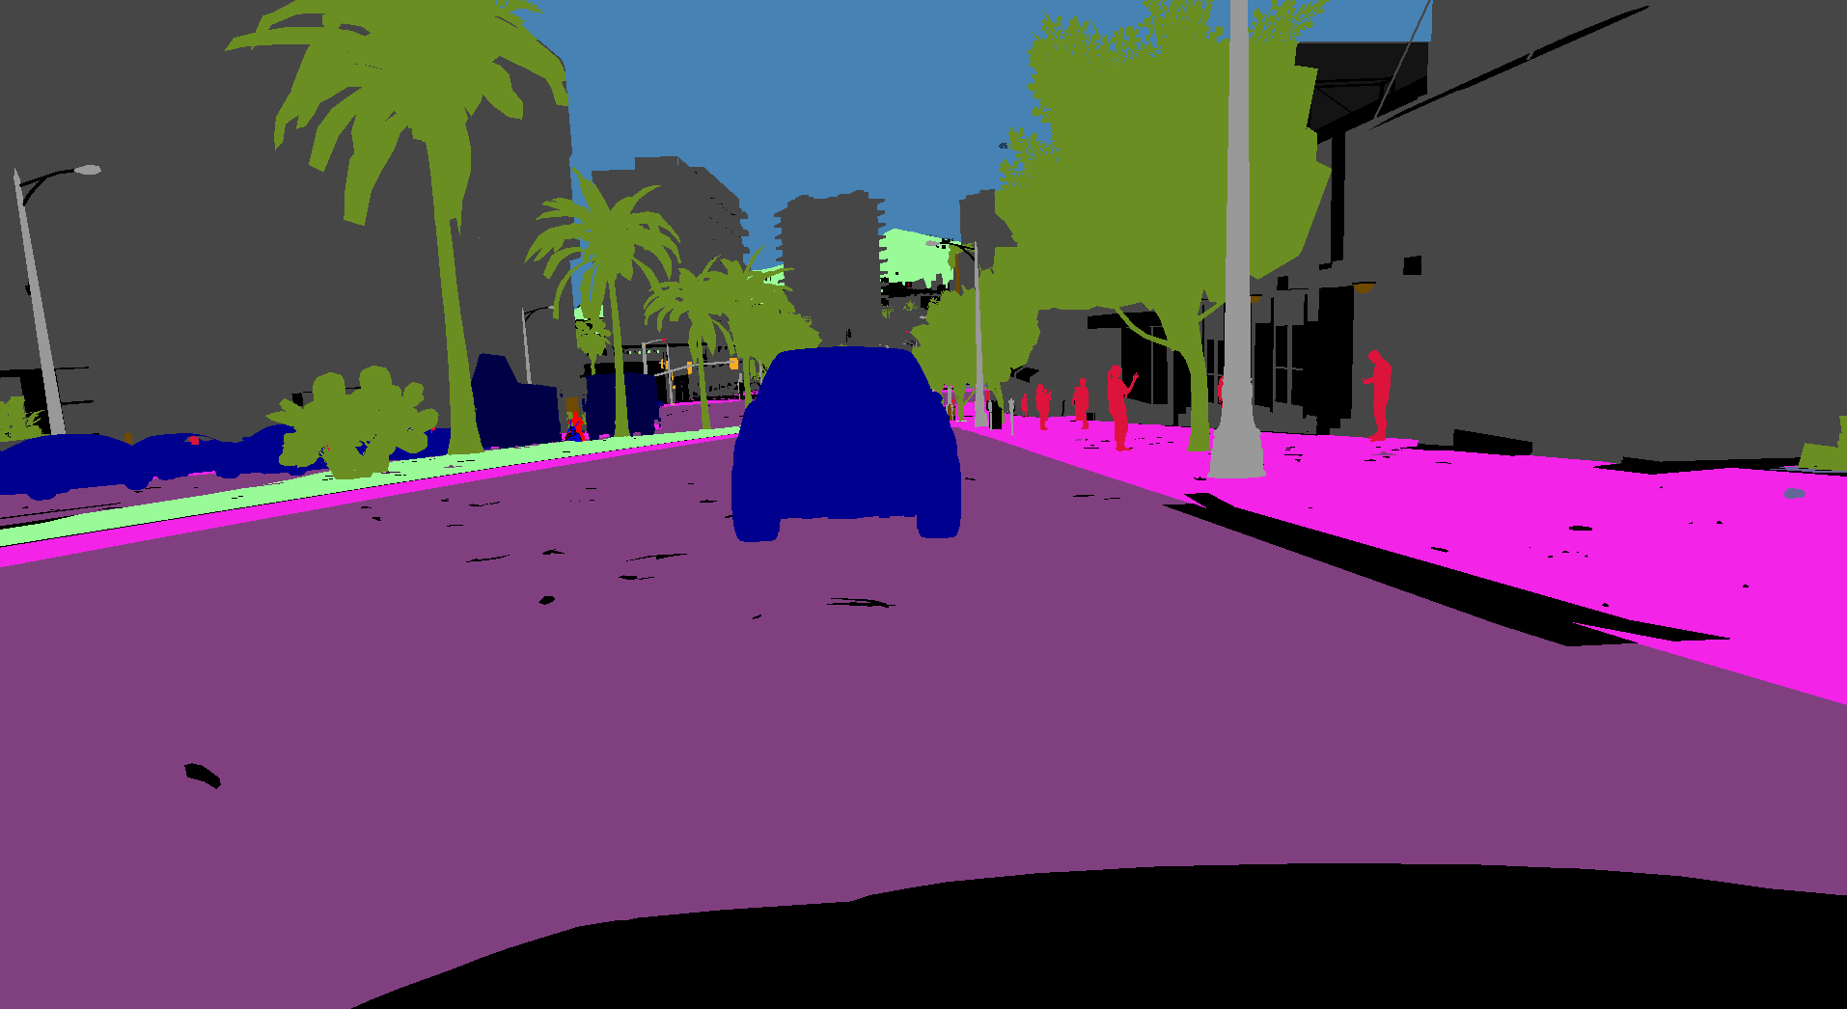
Learning from a different source
Synthetic Images
Easy to acquire
Quicker
Accurate
GTA , Synthia
Notes:
One viable alternative is to learn from a related source dataset where labeled data is easily available. One such example is synthetic datasets, where the images are synthetically generated using computer rendering.

Slide 11
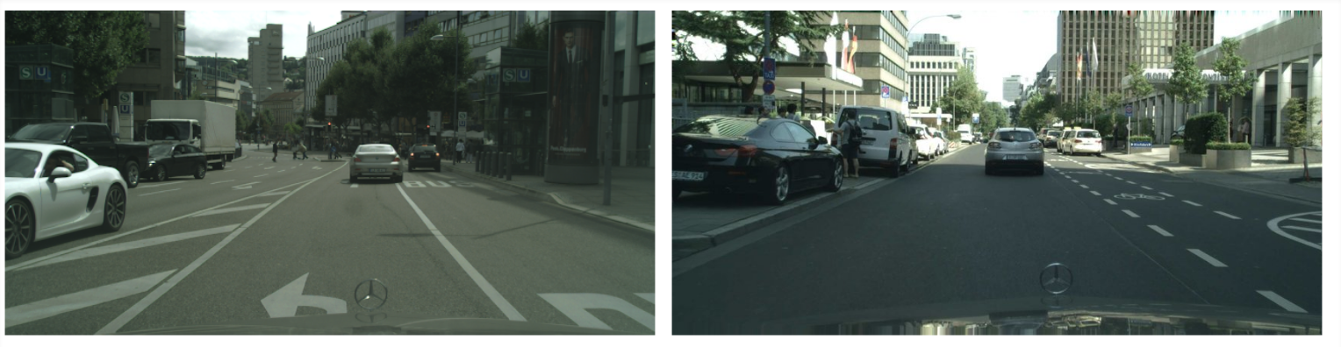

Sim2real domain discrepancy
Synthetic Images
Train Distribution
$≠$
Test Distribution
Domain Gap!!
Real
Images
Notes:
Propreitry, Private, Identity theft

Slide 12
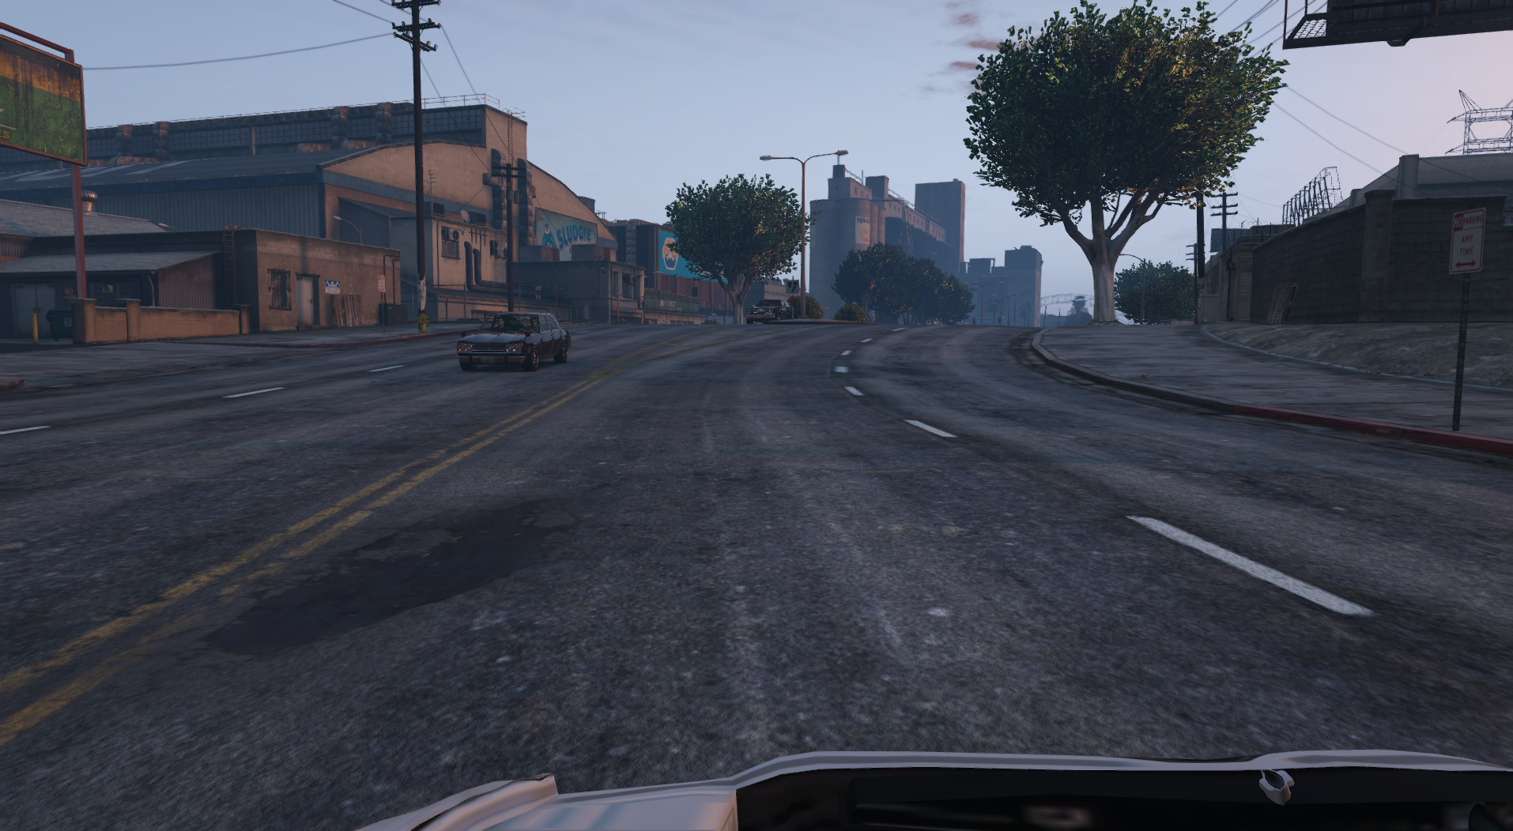
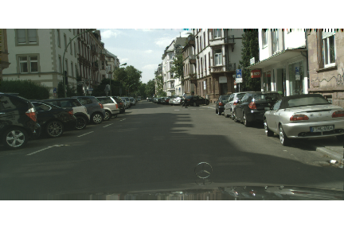
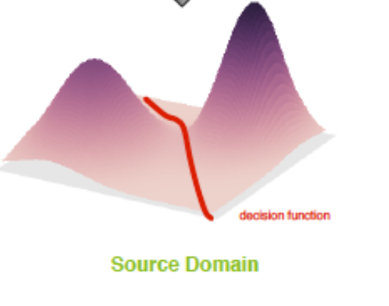
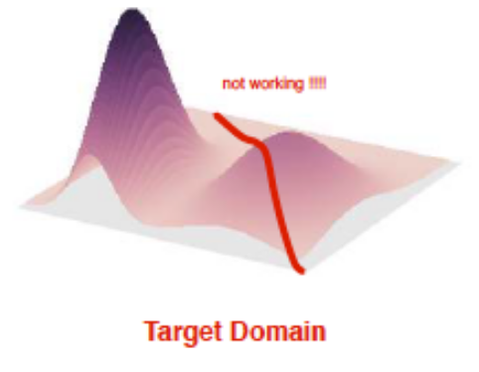
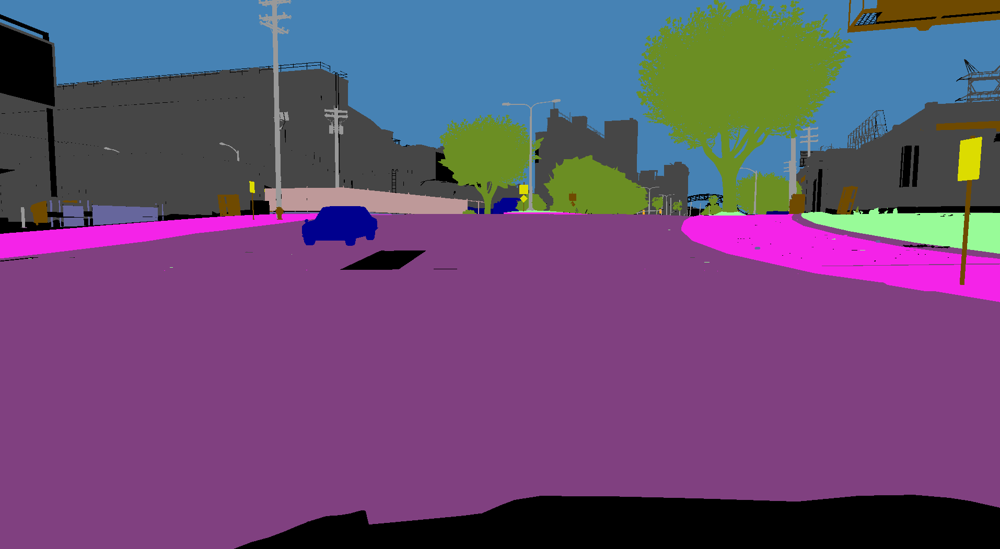
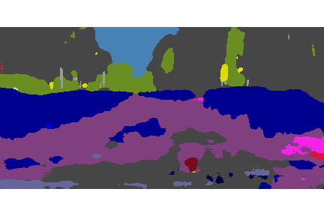
Domain discrepancy hurts transfer learning
Train: Synthetic Domain
Test: Real Domain
Train
Test
mIoU: ~71%
mIoU: ~37%
🙁
Models trained on one source dataset do not generalize to other target images.
Notes:
But problems still remain with using such datasets, most important of which is domain discrepancy.
Low-level details like lighting, style, brightness and weather are widely different in real and synthetic datasets.
talk numbers
this is because of the marginal distribution shift.
This exists for any tasks where source and target datasets have some domain discrepancy.
So are we doomed? It turns out that the answer is NO!

Slide 13
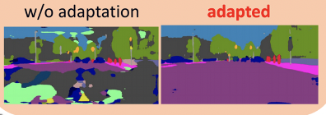
Use Unsupervised Domain Adaptation (UDA)
Source Domain
Target Domain
no labels
labels !!
Adapt
Target Segmentation
mIoU: ~37%
mIoU: ~47%
🙂

Slide 14
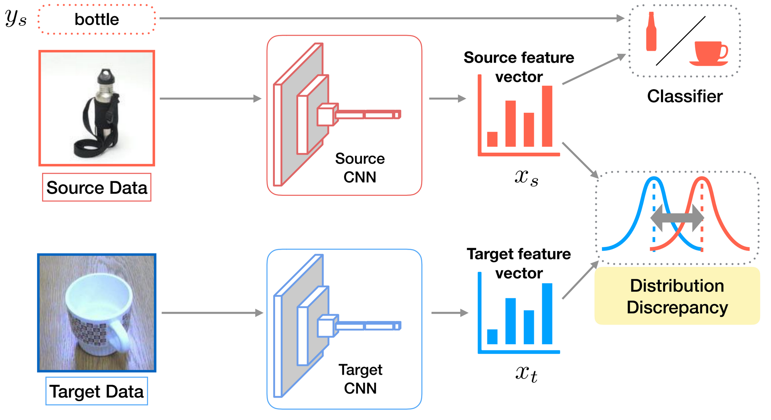
Deep Domain Adaptation
Learning with limited labels, Kate Saenko, ICCV 2019
Notes:
deep domain adaptation generally use technique called as discrepancy minimization. So, in addition to the original training objective like classification cross entropy loss, we also add a regularizer which makes the network to learn representations that reduce the distance between the domain in the feature space.

Slide 15
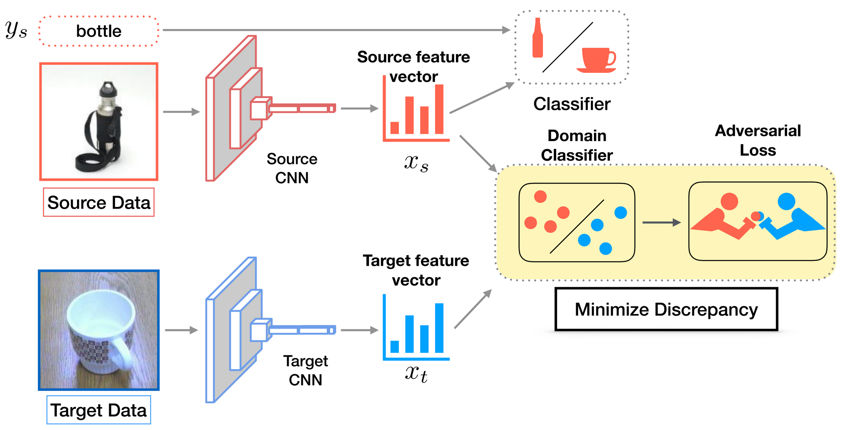
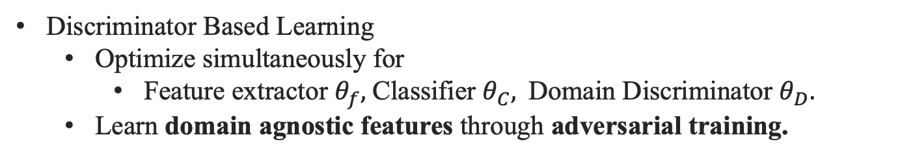
Adversarial Domain Adaptation
Discriminator Based Learning
Optimize simultaneously for
Feature extractor $θ_{f},$Classifier $θ_{C},$Domain Discriminator $θ_{D}.$
Learn domain agnostic features through adversarial training.
Learning with limited labels, Kate Saenko, ICCV 2019
Notes:
Of late, however, much success has been obtained with adversarial domain adaptation, where a domain discriminator is trained to discriminate between the source and target domains. The feature extractor is then asked to learn features in such a manner to fool the discriminator, thereby making the features domain agnostic. The f,c,d are end –to end trained.

Slide 16
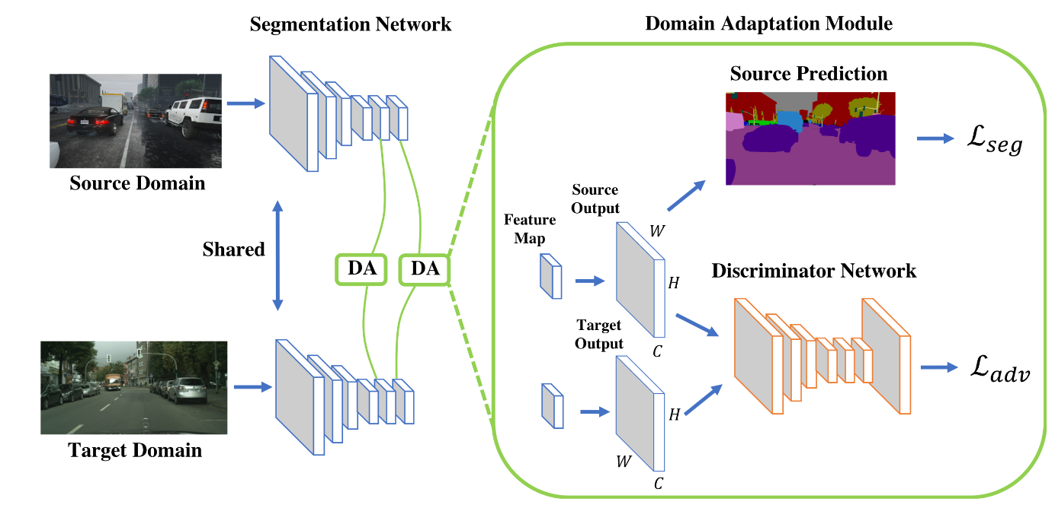
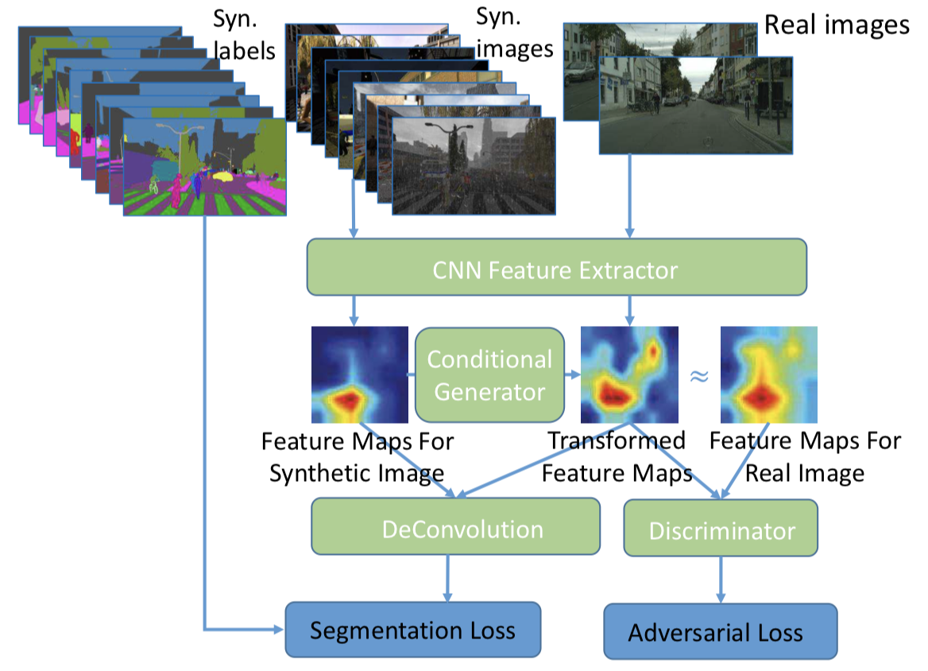
Adversarial training for semantic segmentation
Output space adaptation
Input space adaptation
[Tsai’18 , Hong’18]
Notes:
Discriminator is given as input the output feature map, and then it is asked to fool the discriminator.
Using these techniques, we can achieve reasonably good accuracy when models trained with synthetic data are deployed in real domain.

Slide 17
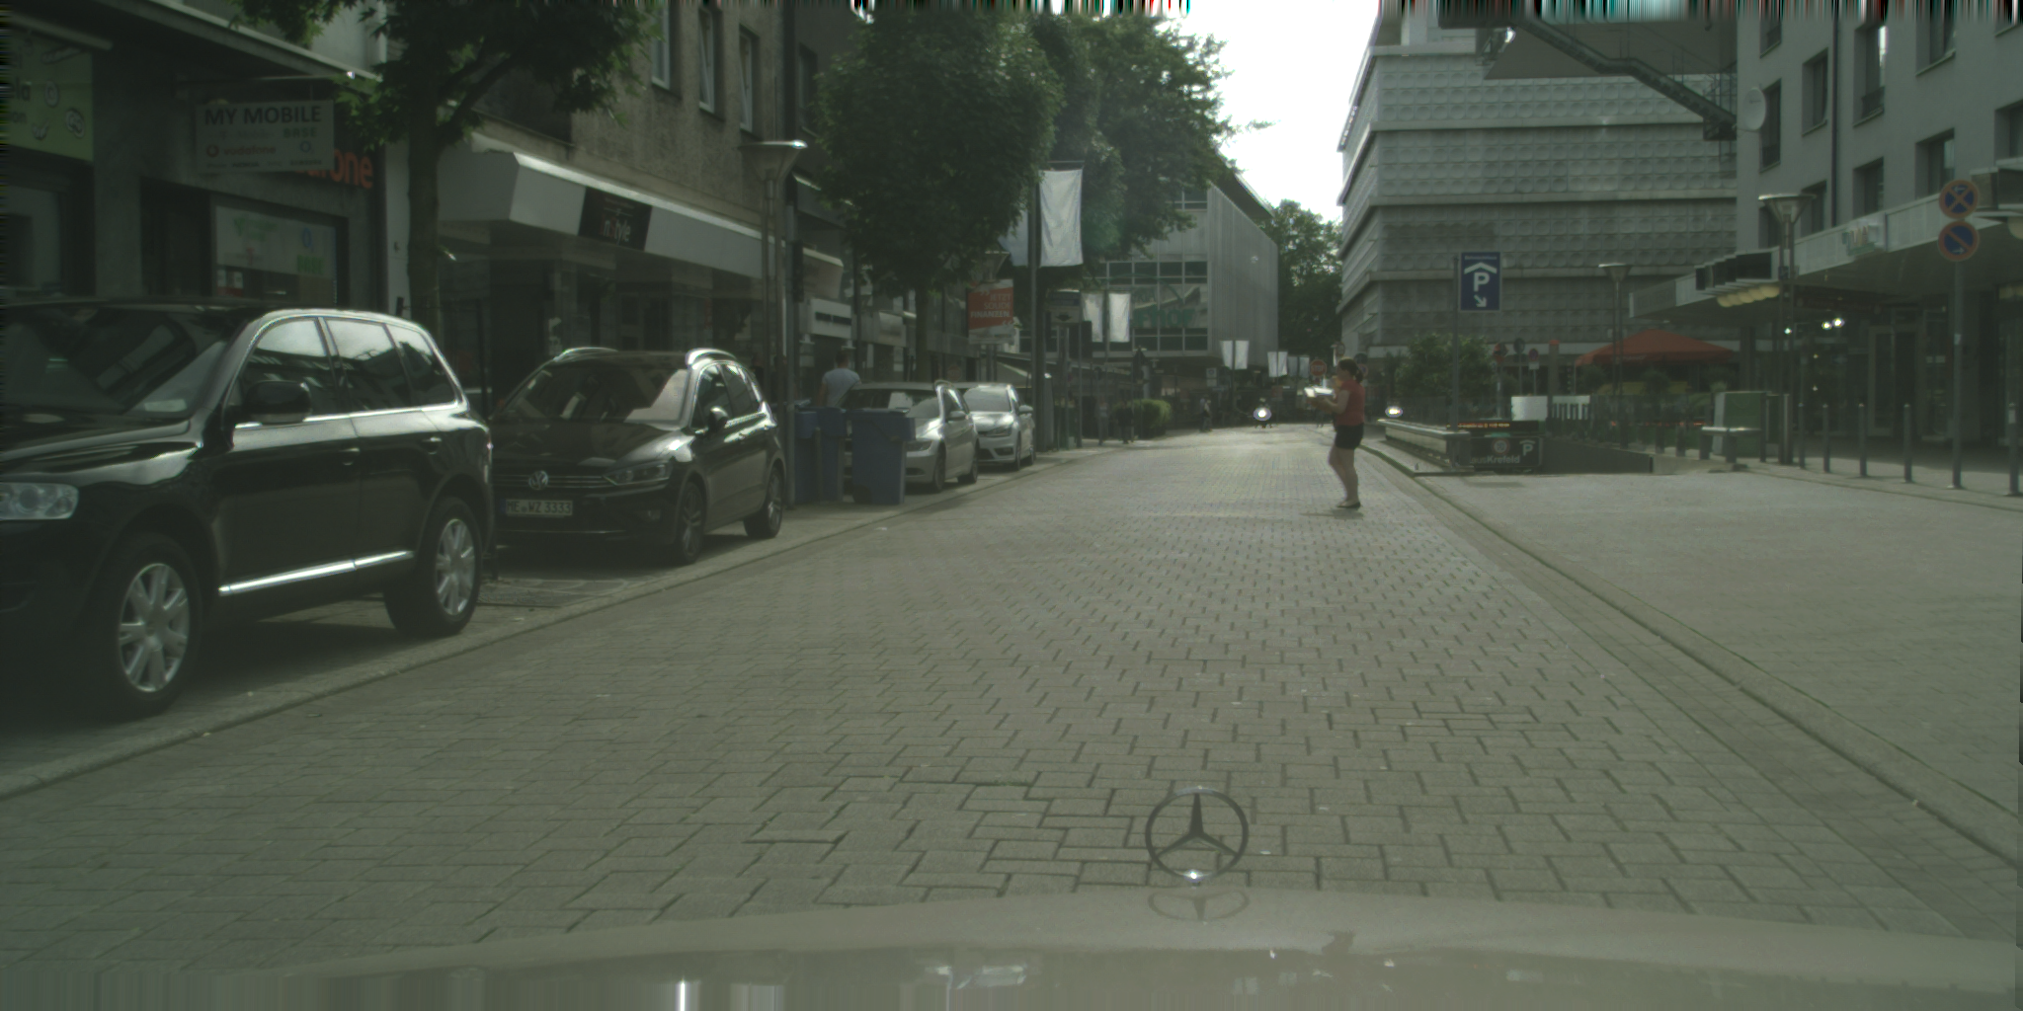
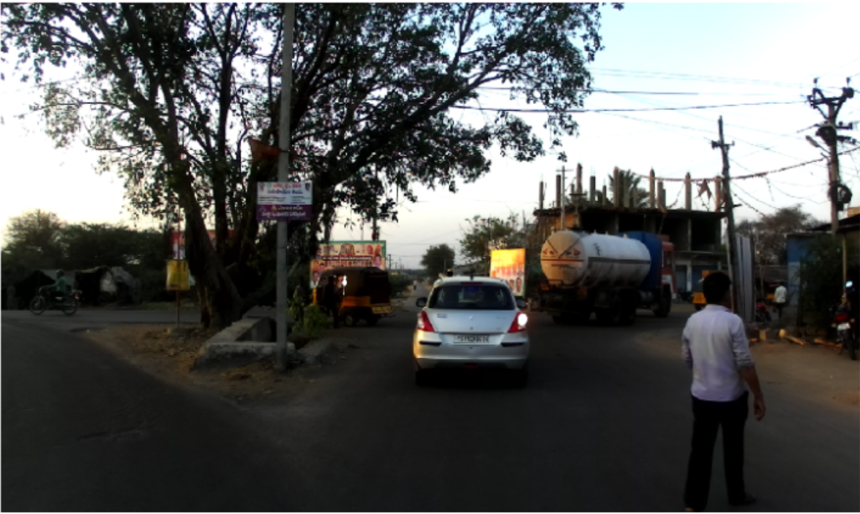
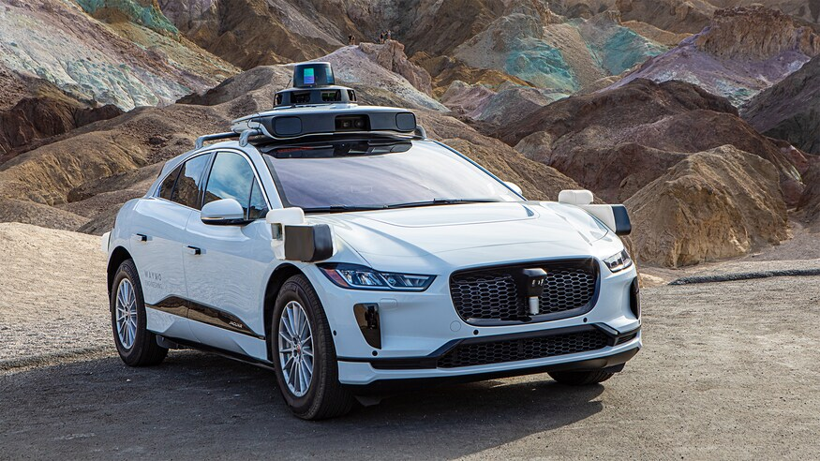
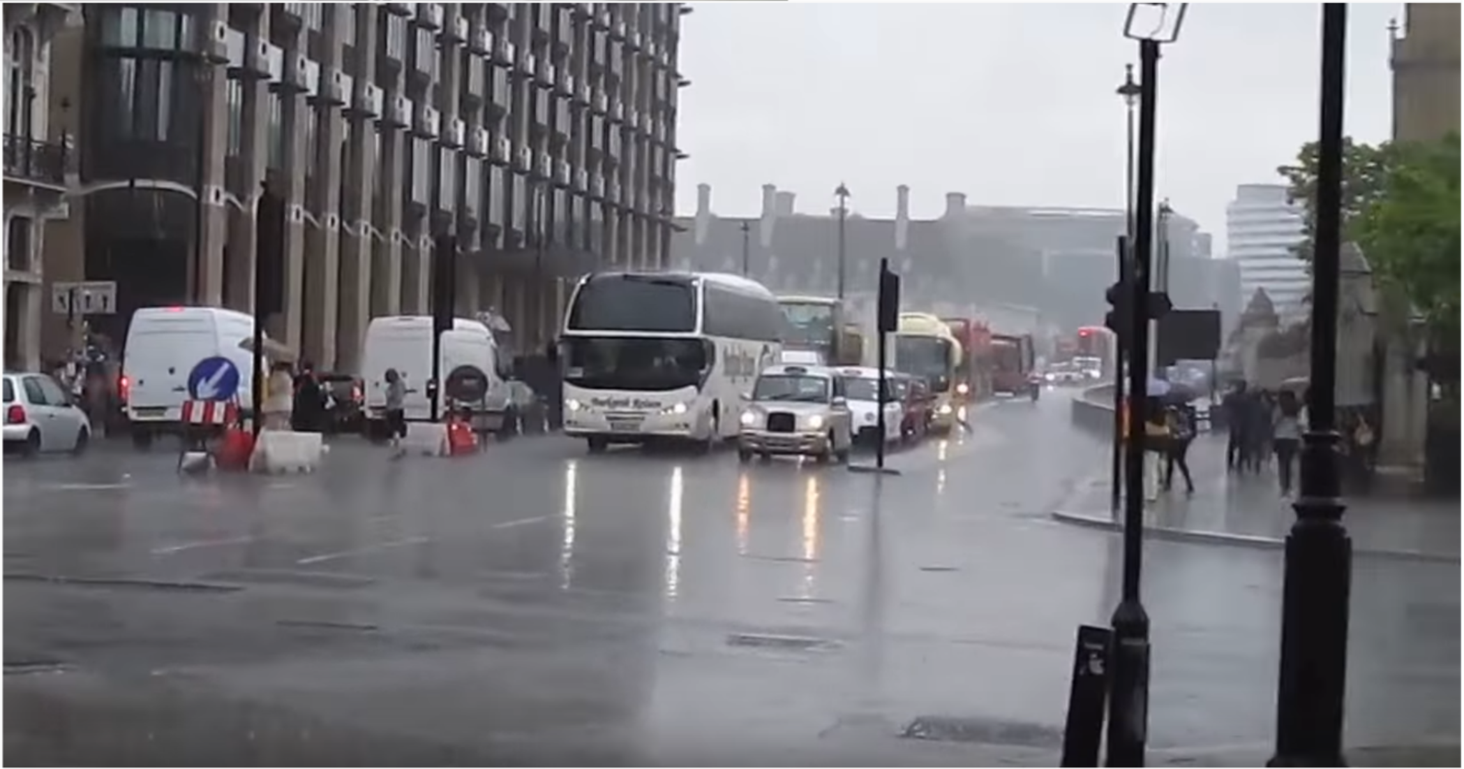
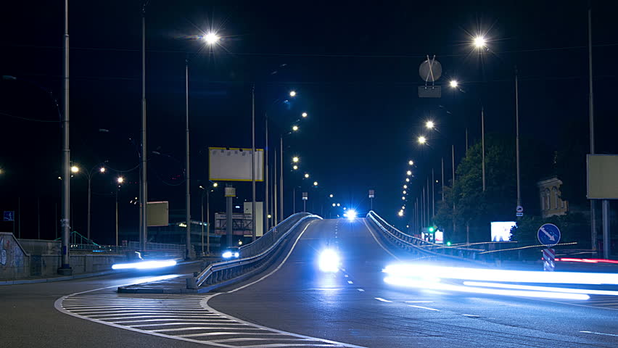
Universal Learning: Adaptation across very distinct datasets
Day Scenes
Unconstrained Scenes
Rainy scenes
Night scenes
Notes:
But ideally, we want something more. What is it?
For example, it might encounter day scenes and night scenes in different times of the day, rainy scenes and different weather as well as highly congested scenes in different geographical locations. I hope you would agree that making autonomous cars which specialize to only one of these settings is not attractive, and not feasible, as cases grow. So, we need to push for learning universal models.
It turns out that the adaptation techniques discussed, while highly effective for moderately separate domains, still fall short in the most general scenario.

Slide 18
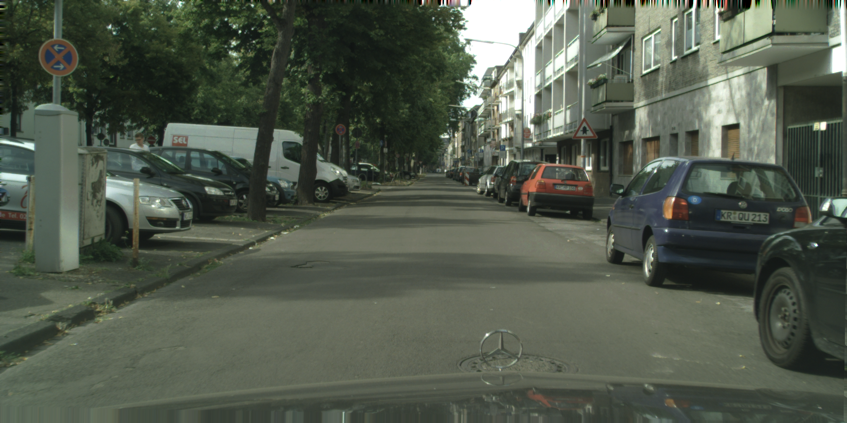
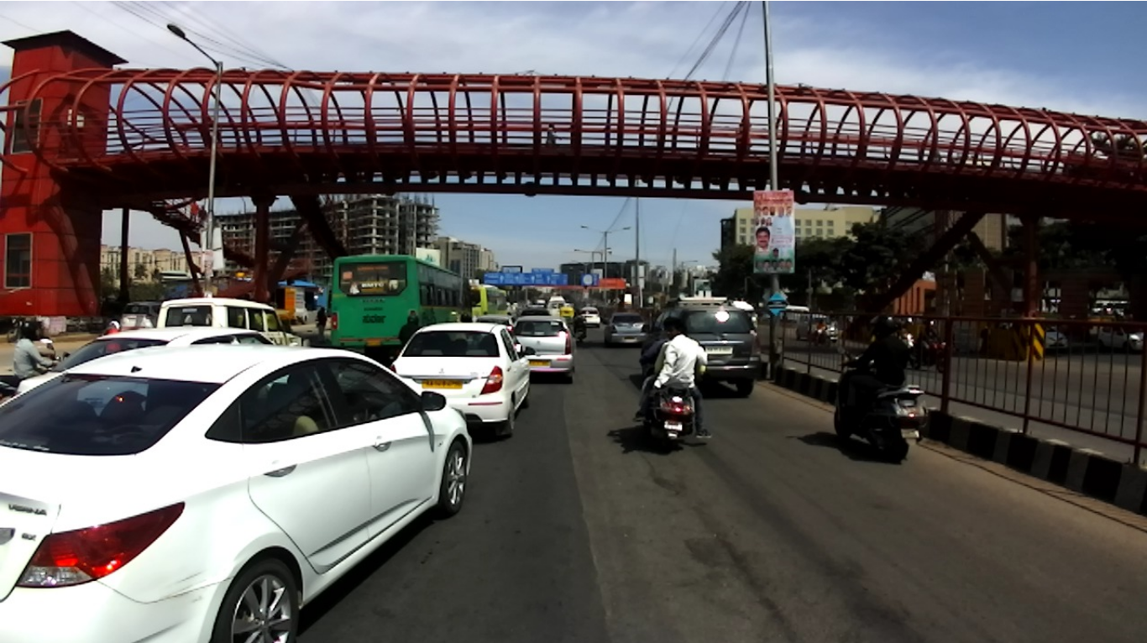
A tale of two cities: Cityscapes vs. IDD
Cityscapes: German Roads
IDD: Indian Roads
Unconstrained
Weather
New labels: auto-rickshaw, local traffic signs
Semantic Shift: Sidewalk (US) vs. Footpath (UK) vs. Pavement (Ind)
Varma, Girish, et al. "IDD: A dataset for exploring problems of
autonomous navigation in unconstrained environments, WACV 2019.

Slide 19
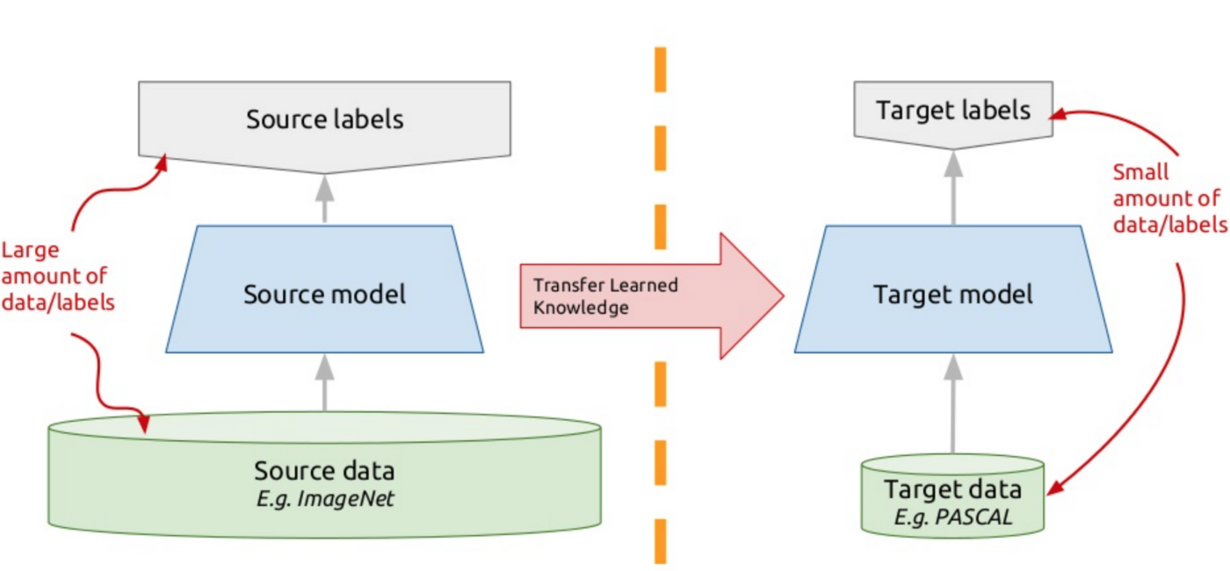
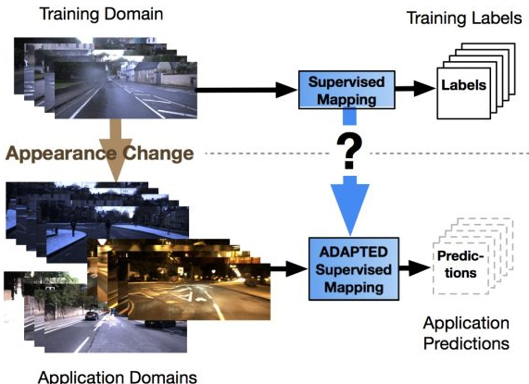
Existing alternatives not suitable for universal learning
Transfer Learning
Domain Adaptation
Low accuracy on source
[Catastrophic Forgetting]
Does not use unlabeled data
Requires large amount target data
Needs same categories across source and target
Requires large labeled data in source domain.
Markus,. "Addressing appearance change in outdoor robotics.”, IROS 2017
Notes:
for adaptation, it requires that the source and target datasets have same categories, which is clearly a non-valid assumption for universal deployment.

Slide 20
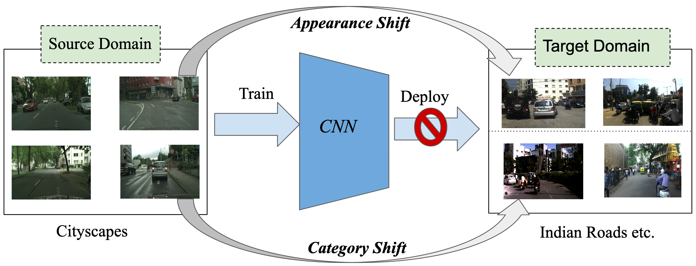
Universal Learning Challenges: Domain Shift + Category Shift

Slide 21
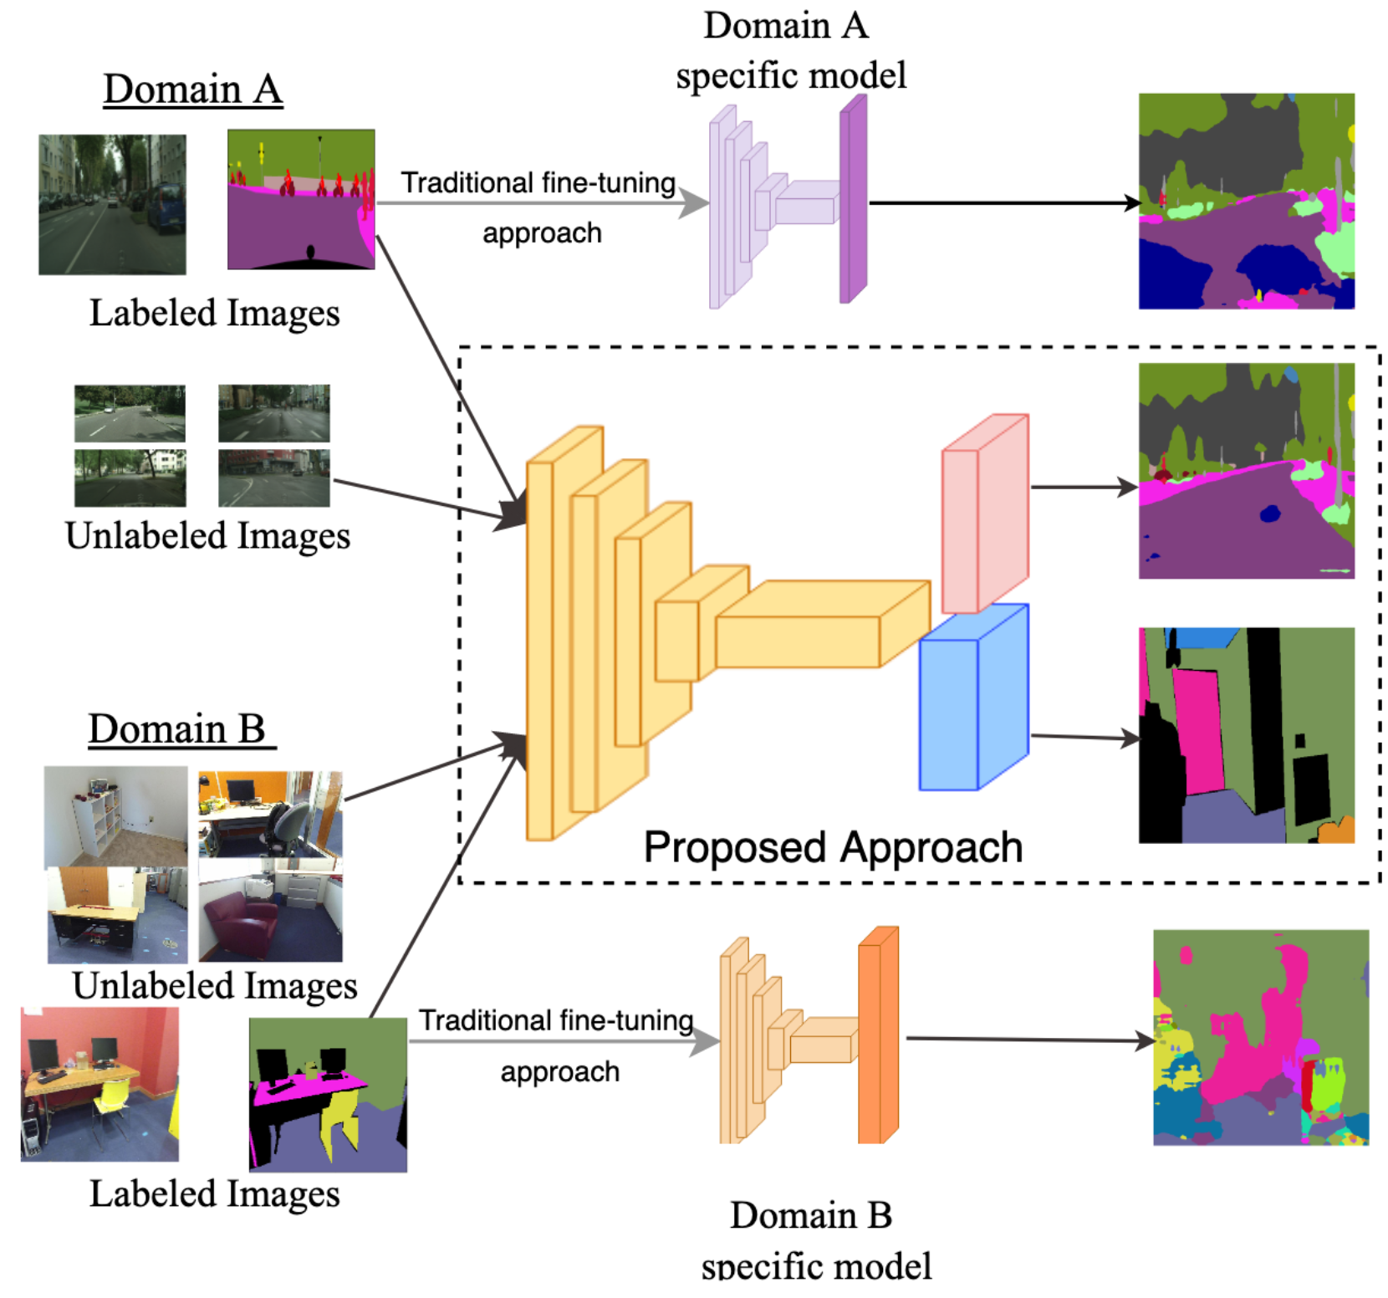

Use Universal Semi-Supervised Segmentation
Few labeled data
+ lots of unlabeled data!
knowledge transfer $→$ better segmentation
Kalluri,. "Universal Semi-supervised Segmentation”, ICCV 2019
Notes:
To tackle this issue, we propose a novel technique for semantic segmentation.
explain data setting
two-way knowledge transfer => works to improve the segmentation performance by extracting the shared semantics.

Slide 22
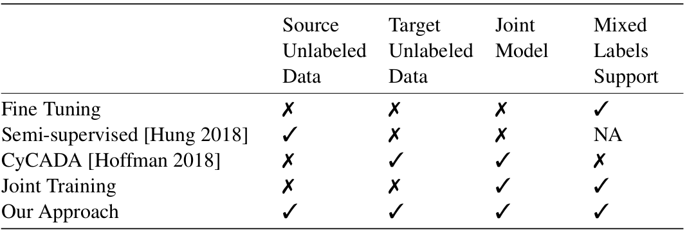
Address semantic shift using unlabeled data
Notes:
Advantages of Universal Segmentation
Joint model across diverse datasets
Mitigate semantic and domain shift using unlabeled data which are more easily available.
Most of which previous works do not do.

Slide 23
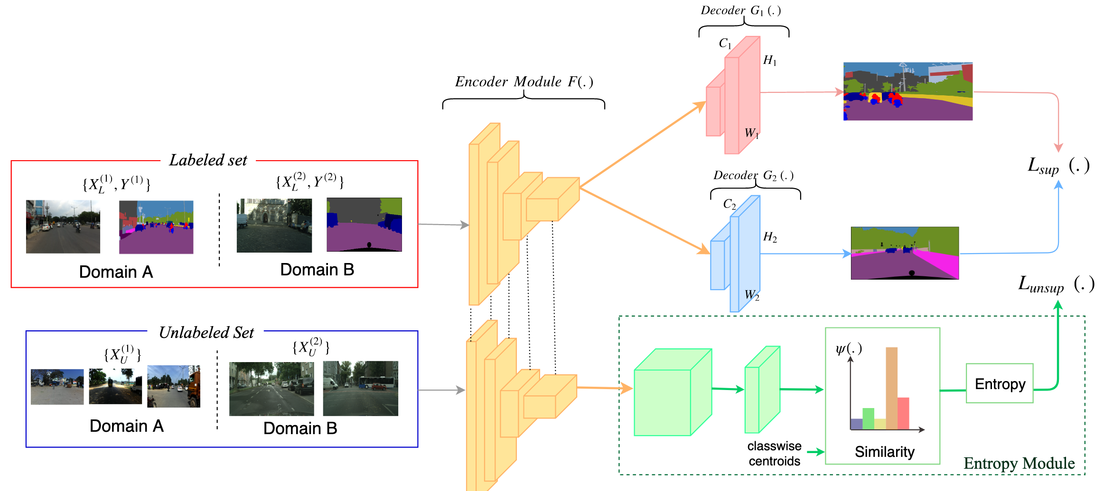
CNN architecture for universal training
Dataset
specific
decoder
Shared Encoder
Entropy Module
(common low-level features)
(label side semantic transfer)

Slide 24


Using entropy regularization for feature alignment
$S\left(.\right)$ : Dot product similarity
$σ\left(.\right):$ Softmax
$H\left(.\right):$Shannon Entropy
= $E\left(−\log{p_{i}}\right)$
Notes:
Entropy minimization, at a very high level, aligns the related labels across the datasets in feature space, and reinforces decision boundaries for labels within a dataset.

Slide 25




Datasets for evaluating universal models
Easy
Hard

Slide 26


Universal models performs better than individual models
Take N=100 labeled examples from each dataset
Method | Evaluate on CS | Evaluate on CVD | Average
Train on CS | 40.9 | 36.5 ($↓14\%$ ) | 38.7
Train on CVD | 22.2 ($↓18\%$ ) | 50.1 | 36.1
Ours Universal | 41.1 ($↑0.2\%$) | 54.6 ($↑4\%$) | 47.8
Universal model on Cityscapes + CamVid
Method | Evaluate on CS | Evaluate on IDD | Average
Train on CS | 64.2 | 32.5($↓18\%$ ) | 48.4
Train on IDD | 46.3($↓18\%$ ) | 55.0 | 50.7
Ours Universal | 64.1 ($↓1\%$ ) | 55.1($↑5\%$) | 59.6
Universal model on Cityscapes + IDD
Notes:
N labeled examples
Average mIoU higher than previous approaches

Slide 27

Universal models performs better than individual models
Method | Evaluate on CS | Evaluate on CVD | Average
Train on CS | 64.23 | 15.47 ($↓35\%$ ) | 39.85
Train on SRGB | 15.61 ($↓40\%$ ) | 42.52 | 29.07
Ours Universal | 57.91($↓7\%$ ) | 43.12($↑0.5\%$) | 50.52
Universal model on Cityscapes + SunRGB
Notes:
N labeled examples
Average mIoU higher than previous approaches

Slide 28


Semantic Alignment for Cityscapes vs CamVid
Sidewalk & Pavement
Naïve Joint Training
Universal Training

Slide 29


Geometrical Alignment for Cityscapes vs SunRGB
Road pixels & Floor pixels
Naïve Joint Training
Universal Training

Slide 30

Refined segmentation outputs on IDD using universal training
Notes:
previous methods do not address the label shift problem or perform as well as we do.

Slide 31


Indoor scene segmentation: Limited labeled data
Synthetic data available only in some preferred domains.
Challenge to create and maintain assets
intricate physical properties hard to simulate
Notes:
hard to create and maintain assets.
lots of intricate physical properties hard to simulate
refer zhengqin talks

Slide 32

Alternative: Transfer from outdoor synthetic images
Outdoor Synthetic
Indoor Real
Effective Solution?
Notes:
hard to create and maintain assets.
lots of intricate physical properties hard to simulate
refer zhengqin talks

Slide 33










Outdoor to Indoor : Disjoint Labels
Outdoor Images
Indoor Images
Transfer
Fully Labeled
Few labels
Building,
Sidewalk,
Pole,
Sky,
Road,
Car, $$⋮$$
Table,
Wall,
Chair,
Floor,
Books, $$⋮$$
Disjoint Categories!
$$≠$$
Notes:
Ours is the first work that systematically studies the problem of adaptation between indoor and outdoor datasets, while proposing a computationally efficient and effective way to handle the transfer.

Slide 34

Negative transfer
Classical adversarial feature-based alignment would give rise to unwanted negative alignment.
Pull similar labels closer to each other while preventing negative alignment.

Slide 35

Clustering for label alignment
Use clustering to pull semantically closer feature vectors closer to each other, while pushing apart unrelated/competing features.
Outdoor
Labels
Indoor
Labels
Notes:
Explain each of these modules.
The different loss functions are explained next.

Slide 36

Adapt and Transfer Using Clustering
Notes:
Break the problem into within task and cross task adaptation.

Slide 37

Network Architecture
End to end trainable
Notes:
Explain each of these modules.
The different loss functions are explained next.

Slide 38

Deep Constrained Clustering
Traditional clustering works on input images, the clusters need not be semantically meaningful.
Additional constraints to group semantically similar representations closer to each other.
In our problem, the constraint is in the form of a discriminative constraint on the feature space.
[Basu’06, Caron’18, Xie’16]
Notes:
Combine ideas from deep representations learning and constrained clustering.

Slide 39


Deep Clustering Objective
Enforce subspace clustering using a k-means objective on the features.
Encourages features semantically similar across tasks to group into a single meta-cluster.
Given cluster centers $μ_{k}$ and feature vectors $v_{j}$, the clustering loss is given by
where,
Cluster Assignment Probability
[Han’16]

Slide 40








Experiments
Datasets
Target Task
Unlabeled Bridge
Cityscapes
Fewshot Target
SUNRGB-D
Labeled Source
GTA, Synthia etc.
~25k images
Synthetic
Computer Labeled
20 categories
~4k images
Real
Unlabeled
Indoor Scenes
Real Images
~5k Total Images
13 categories
$“σ”$ fraction of images in SUN dataset are labeled
mean Intersection over Union (mIoU) is the performance metric.
Notes:
Explain each of these modules.
The different loss functions are explained next.

Slide 41


Experiments: mIoU on SunRGB dataset
$$σ :fraction of labeled data$$
Method | $σ=0.01$ | $σ=0.04$ | $$σ=0.10$$
Target only | 22.62 | 30.43 | 36.62
Finetune | 21.44 | 29.46 | 34.84
Crosstask adaptation | 25.98 | 33.37 | 37.41
Notes:
N labeled examples
Average mIoU higher than previous approaches

Slide 42

Qualitative Results on SUNRGB
Input
Only Adversarial
Ours
Ground Truth

Slide 43
Summary
1. Domain adaptation needed to overcome annotation overhead.
2. Universal Segmentation enables effective knowledge transfer and improves performance.

